Slide 1
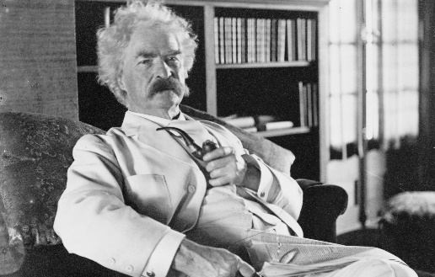
Thought Leader (Recognized Expert)
Evangelist
Audience
Audience
???
Unknown
Expert
Content
Content
Source: Mitchell Levy http://www.thinkaha.com/thought-leadership-defined/

Slide 2
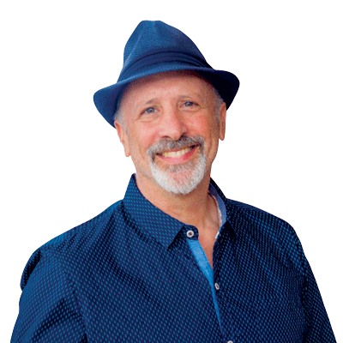
To Continue the Conversation
Mitchell Levy
The AHA Guy
& CEO, THiNKaha®
submission@thinkaha.com
408-257-3000
http://THiNKaha.com
http://ThoughtLeaderLife.com
http://AHAthat.com
8-Step Author Process
http://AHAthat.com/Author
Copy of these slides
http://aha.pub/TED-AHAslides
http://TheAHAGuy.com
http://aha.pub/t-l-b-p

